Slide 1
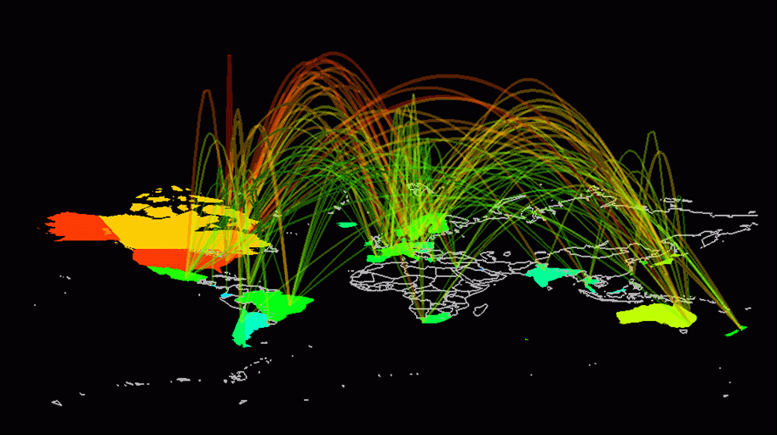
Lecture
1
Computer Networks

Slide 2
What are
Computer Networks
Notes:
Since this course is about “Computer Networks”, it is in place to firstly define Computer Networks. Since computer networks are highly complex, it is hard to provide a single line definition. We will instead take a more descriptive approach.

Slide 3
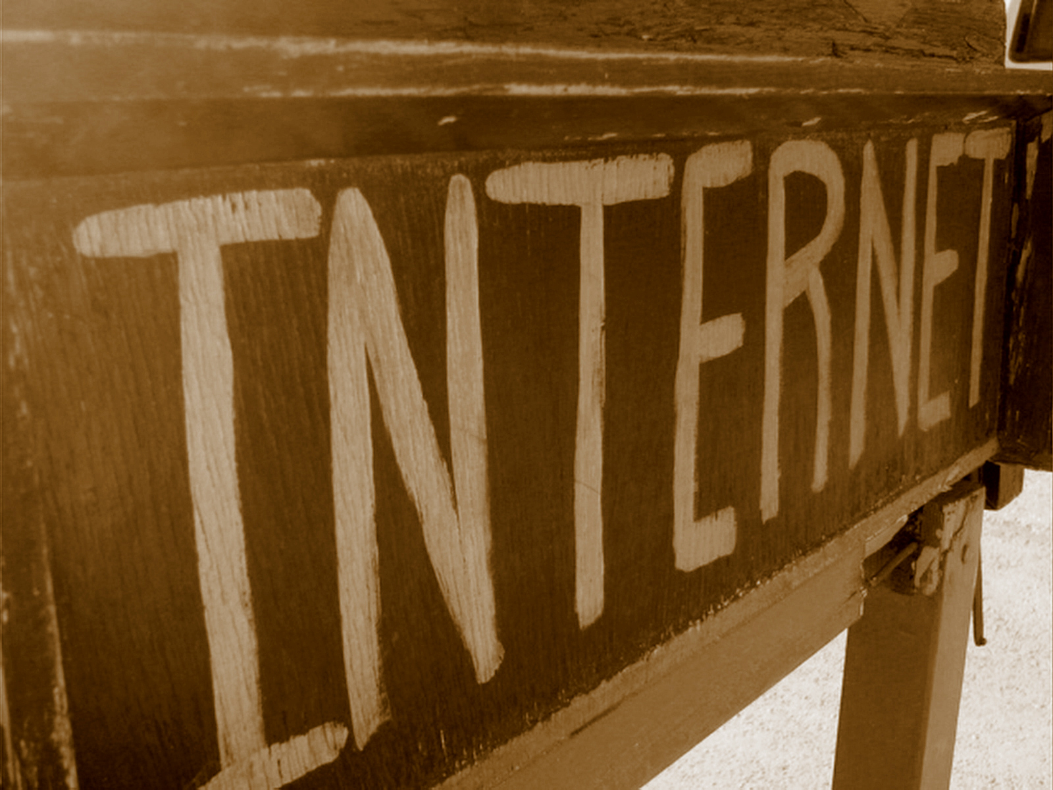

Slide 4












Everyday network based applications
Internet is pervasive
World Wide Web – a framework that runs on top of the Internet
Business
Information
Education
Notes:
Image sources: the logos are copyrighted by their respective owners
ATM machine: http://www.atmexperts.com/images/large_atm_photos/tidel_3100.jpg

Slide 5
Why study
Computer Networks

Slide 6

1
Increased professional opportunities

Slide 7

2
Increased productivity
through efficient usage of networking technology
Notes:
Source: http://4uc.org/secure/302/33430/download/images/Icon2.jpg

Slide 8

3
Develop skills to engineer
state-of-the-art innovations

Slide 9
4
Improved employment
and earning potential
Income
Time

Slide 10
Approaches to studying
Computer Networks

Slide 11
Focus/ emphasis on:
Configuring networking products
Creating networking software
Understanding network protocols
Core principles that have shaped popular networking protocols
The emphasis of this course will be on 3 and 4.
(Some aspects of 1 and 2 as well.)

Slide 12
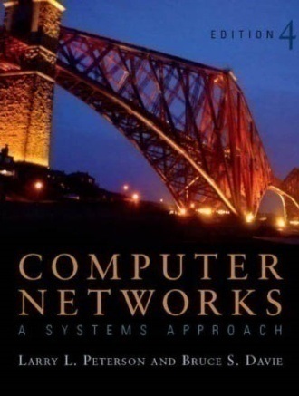
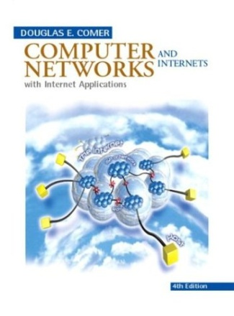
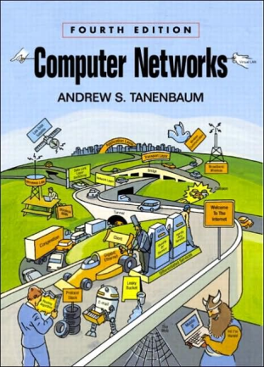

Course books

Slide 13

Text book:
“Computers Networks –
a systems approach”
by Peterson and Davie
[P&D]

Slide 14
Book’s philosophy:
“System’s approach”
Problem-solving approach
Focus on core design choices
Focus on perspective rather than solely on specifications
Examples with real Internet protocols

Slide 15

Reference book:
“Computers Networks and Internets”
by Douglas E. Comer
[Comer]

Slide 16
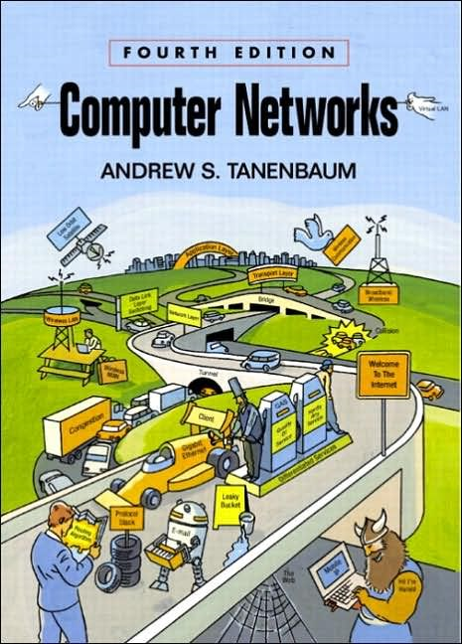
Reference book:
“Computers Networks”
by Andrew Tanenbaum
[Tanen]

Slide 17
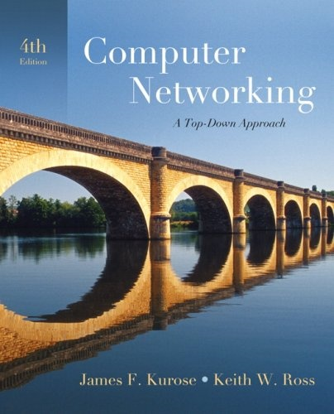
Reference book:
“Computers Networks”
by Kurose and Ross
[K&R]

Slide 18
Course Outline

Slide 19

Overall Problem: How to build a scalable heterogeneous network
Topic 1: Foundations of networks
?
Notes:
Scalable is defined as:
“Scalability is a desirable property of a system, a network, or a process, which indicates its ability to either handle growing amounts of work in a graceful manner, or to be readily enlarged.” (Wikipedia)
We would like to build a computer network that has the potential to grow to global proportions and support diverse applications such as teleconferencing, video on demand, electronic commerce, distributed computing, etc.
Answering this question is the overriding goal of this course. We have chosen a textbook which also traces this fundamental question as its overriding theme.

Slide 20
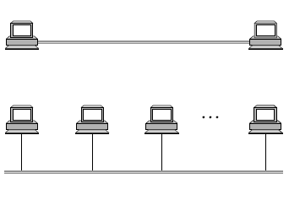
Problem: How to directly connect nodes into a single network
Topic 2: Direct link networks
?
Notes:
The simplest network possible is one in which two hosts are directly connected by some physical medium. This is also called a point to point link. This point to point link can be a length of wire, a piece of optical fiber, or a medium through electromagnetic radiation can be transmitted.
There are five problems that must be addressed before nodes can directly exchange packet even when they are directly connected.
Encoding problem
Framing problem
Error detection problem
Reliable delivery problem
Media Access Control problem
These five issues are dealt separately by different protocols that work at the direct link layer level.

Slide 21
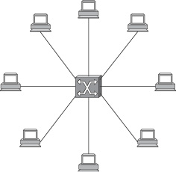
Problem: How to connect nodes that cannot be directly connected (for any reason including cost)
Topic 3: Packet Switching
?
Notes:
In the directly linked networks we studied in topic 2, there are two primary limitations.
Limit of number of nodes that may be attached.
Limit to how large a geographical area can be covered.
E.g., Ethernet can span only 2.5 Km and allow no more than 1024 hosts.
Since our overall problem is to form networks that are global in scope, we need to enable communications between nodes that are not directly connected.
This problem is similar to that addressed in a telephone network. We are not physically connected with every person having a telephone in the world but is connected to an exchange called a switch. Computer networks use packet switches to give the illusion that we are connected to all possible receivers.
A packet switch is a device with many inputs and outputs learning to and from devices that connect to the packet switch. The core job of a switch is to take packets that arrive on input and switch them to the right output so that they will reach their appropriate destination.
Two kinds of packet switching. The first is LAN switching which evolved from Ethernet bridging to become the dominant technology for LAN environments. The second core technology is ATM/ MPLS which is used in wired environments.

Slide 22
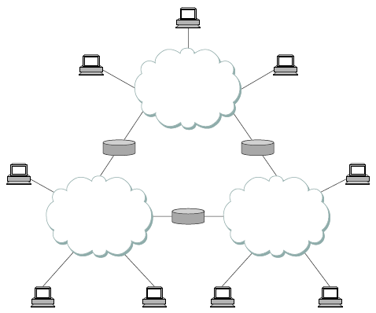
Problem: How to interconnect nodes belonging to different networks
Topic 4: Internetworking
?
Notes:
We have seen how to build a single network using point to point links, shared media and switches.
The problem is that lots of people have built networks with these various technologies and they all want to be able to communicate with each other, not just with the users of the same network.
Since our goal is to build global networks that can support diverse applications, it is important to address the two main obstacles to internetworking---heterogeneity and scale.
The problem of heterogeneity is that users on one type of network want to be able to communicate with users on other types of networks. To further complicate matters, establishing connectivity between two different networks may require several other networks in between, each of which may be a different type. (E.g., Ethernet, token ring, apple talk, point to point links, etc.) The challenge of heterogeneity is to provide a useful and fairly predictable host-to-host service over a hodge-podge of different networks.
An important problem here is of routing.
The other problem is of scale. The solution should adapt with increasing requirements of users and data.

Slide 23
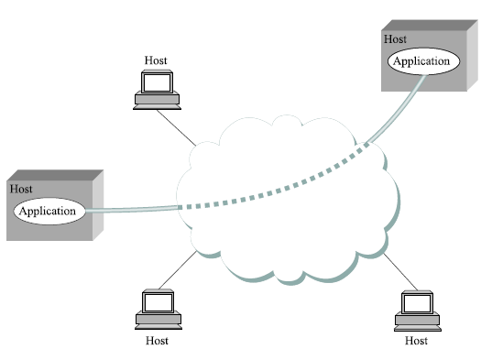
Problem: How can processes on different nodes communicate efficiently
Topic 5: Process Communication
?
Notes:
We have seen how computers can be connected---direct links, switches, and internets. Now we want this host-to-host delivery service to service process-to-process communication. This problem is also called the end-to-end protocol problem.
We not only have to connect hosts in different network, but also ensure:
Guaranteed and Ordered message delivery between processes
Allow receiver to apply flow control
Support multiple processes on each host.

Slide 24
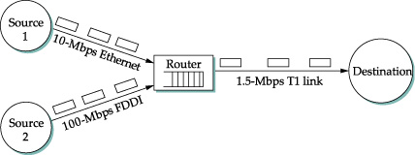
Problem: How to ensure that communication links are not overburdened
Topic 6: Congestion Control
and Resource Allocation
?
Notes:
The problem is how to effectively and fairly allocate resources among a collection of competing users.
Congestion control and resource allocation are two sides of the same coin. If the network takes an approach to resource allocation, congestion can be avoided.

Slide 25
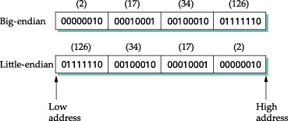
Problem: How to translate the (potentially) different data representation formats on different networks/ nodes
Topic 7: Data Representation
?
Notes:
From the network’s perspective, application programs send messages to each other as uninterrupted strings of bytes.
From the application’s perspective, these message contain various kinds of data---video, text, images, etc. In other words, these bytes have meaning.
The concern is that receiver should be able to extract the same message. The second concern is efficiently sending this meaning in least bits.

Slide 26
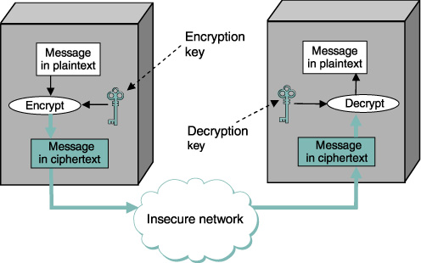
Problem: How to ensure the security of network and the data that traverses on it
Topic 8: Data/ Network Security
?
Notes:
The Internet is a globally shared network that is accessed by both the good guys and the bad guys.
The bad guys would like to subvert the normal operation of the Internet for malicious purposes. Unless active security measures are taken, various kinds of security attacks (also called cyber attacks) can be perpetrated.
Confidentiality, integrity and authenticity can be compromised.

Slide 27
Problem: How to design protocols for applications that use networks
Topic 9: Application layer protocols
?
HTTP
SMTP
IMAP
FTP
POP
SNMP
DNS
SIP
Notes:
In the end, the end-users of networks interact using applications. Applications also must have a protocol to ensure their operation.
For example, web browsers use the HTTP protocol for exchanging data with webservers. We will cover in this topic popular application layer protocols.

Slide 28

Problem: How to monitor the performance of networks and manage them to ensure proper operation
Topic 10: Network Management
?
Notes:
Since so much now depends on the Internet and on networks in general, it is important that these networks are properly managed.
Any problems that arise must be promptly diagnosed and rectified to minimize downtime. Downtime can significantly impact different business.
Network monitoring is a sister field of network management.
Source: http://www.bit.com.my/v3/images/stories/isd_solutions/carrier_system/network_man.jpg

Slide 29



Practical Networking
Notes:
Apart from studying Computer networks, we will also survey briefly how computer networks work practically. This will be an excellent opportunity for the students to gain practical skills that are highly appreciated in the industry.
This component will be primarily done through assignments and term projects since we don’t have a lab component of this course.
We will study how various networking vendors (Cisco, Juniper) products can be simulated and try to become familiar with their configuration interface.
http://www.bciscs.com/images/Partner%20Logos/CiscoSyste
http://www.danddhosting.com/images/linuxlogo_cs1.jpgms_24.gif

Slide 30
Course Policies

Slide 31
Evaluation breakdown
Notes:
A brief discussion on Admin related stuff. Please pay attention since these are very important rules that we are going to define and implement.
Firstly, I want all of you to be responsible for ensuring class discipline. This includes not talking amongst yourself when the instructor is speaking. Please respect all the participants of this class by not creating any disturbance for any one.
We have a policy in this class that mobile phones would be turned OFF. Please respect this rule to help enhance your and your class fellows learning experience. I advise that laptops not be used during class especially during an ongoing lecture unless you have asked for permission.
If any one of you has any kind of learning disability/ or any special need, please apprise me of the same, and we’ll try to fix up something.
It’s very important that you get acquainted with course’s website. You’d be able to find the link to the course-website by visiting my website and then following the Teaching tab. Alternatively, you can directly visit the course-website, using the link: http://www.niit.edu.pk/~junaid.qadir/ict-webiste.html. All the important course-related information/ announcements would be added on the course-site, and it’s the responsibility of the students to stay up to date.
The evaluation breakdown is as follows: 30% Mid Term, 40% Final Exam, 30% - Project /Term Paper (10%), Assignments (10%), Quizzes (10%).

Slide 32
Policies/ Administrivia
Class discipline
Mobile phones and laptops
Learning disabilities/ Special needs
Course website on LMS
Attendance policy; Assignment policy
Quizzes (announced/ unannounced)
Learning Participation
Notes:
A brief discussion on Admin related stuff. Please pay attention since these are very important rules that we are going to define and implement.
Firstly, I want all of you to be responsible for ensuring class discipline. This includes not talking amongst yourself when the instructor is speaking. Please respect all the participants of this class by not creating any disturbance for any one.
We have a policy in this class that mobile phones would be turned OFF. Please respect this rule to help enhance your and your class fellows learning experience. I advise that laptops not be used during class especially during an ongoing lecture unless you have asked for permission.
If any one of you has any kind of learning disability/ or any special need, please apprise me of the same, and we’ll try to fix up something.
It’s very important that you get acquainted with course’s website. You’d be able to find the link to the course-website by visiting my website and then following the Teaching tab. Alternatively, you can directly visit the course-website, using the link: http://www.niit.edu.pk/~junaid.qadir/ict-webiste.html. All the important course-related information/ announcements would be added on the course-site, and it’s the responsibility of the students to stay up to date.
The evaluation breakdown is as follows: 30% Mid Term, 40% Final Exam, 30% - Project /Term Paper (10%), Assignments (10%), Quizzes (10%).

Slide 33
Reading Assignments
Classical papers
Sections from the textbook [P&D]
Sections from the reference books [K&R, Tanen, Comer]
Highlighted at the end of the lecture or at the course website

Slide 34
Programming Assignments
Network software leads to the great versatility of computer networks
Sockets Programming (using Python)
Aim is to understand how popular Internet protocols work

Slide 35
Late submission policy
A single 1 day grace period will be provided for some tasks (e.g., one late assignment or programming assignment (by 1 day) is acceptable)
50 % deduction for a late submission (up to 1 day); not acceptable after 1 day.

Slide 36

pedagogical principles
We are potential teachers as well as learners
We learn a lot from the act of creating or expressing something for others.
We learn a lot by just observing our peers.
By understanding the contexts of others, we can teach/ learn better (constructivism)

Slide 37
Activities in this course
Social bookmarking
Collaborative class lecture notes (using wiki)
Online discussion forums
Emphasis on enhancing learning through collaboration and sharing
5% marks for quality participation
in these activities

Slide 38
?
?
?
Questions/ Confusions?

